Slide 1
Lab 2: Hacking the Core
"Instructions Not Included"

Slide 2
What?
Add new instructions to alu.sv
  don't forget definitions.sv
Call these new instructions from .asm
  via .hex (hardware's "assembly code")
  don't forget to re-run Java

Slide 3
So What?
Speed up generic general purpose processor by adding new special purpose instructions
  upside
    fewer clock cycles to do the job at hand
  downsides
    clock rate
    cost (chip area)
    power consumption

Slide 4
What's in the Core?
PC: steps through program
instr_mem: decodes instructions into
  reg_file addresses & alu opcode
reg_file: supplies operands to alu
alu: 32-bit operands (2), 5-bit opcode
cl_decode: memory control logic
data_mem: external, unlike MIPS

Slide 5
Vanilla Core
open DataPath Diagram (Q1).pdf

Slide 6
SystemVerilogisms
In definitions.sv:
  `define kADDU 16'b00000_?????_??????
In adder.sv:
  unique case (op_i)
  'kADDU: result_o ... ;
Match only 5 upper bits of imem out
  [15:11] alu op code
  [10:06] rd_addr
  [05:00] rs_addr

Slide 7
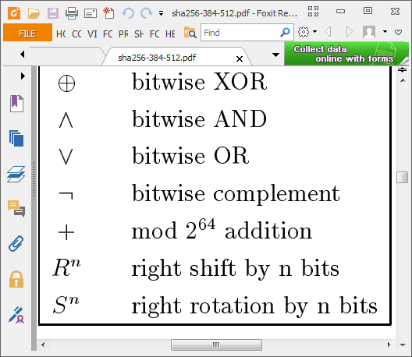
SHA256 algorithm

Slide 8
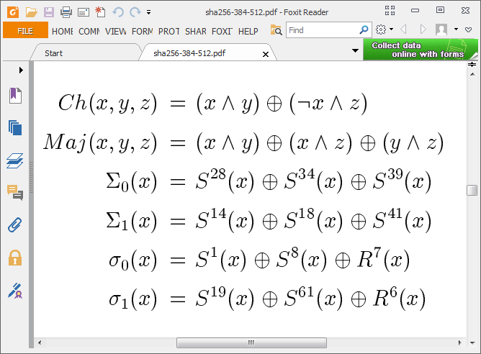
SHA256 key operations

Slide 9
Demo
Bitcoin mining w/ baseline design
Watch the signal & data flow
Note changes to my TB

